Slide 1
BRANCH ANNUAL GENERAL MEETINGS
2018
Notes:
The review of the org structure is a strategic initiative undertaken to determine the best possible design for NZISM to support our projected growth and increased delivery of valuable benefits to members.
There will be a member vote at the next AGM in September on this change. Members will have the opportunity to vote to accept the changes and therefore change some of NZISM rules affected by the new structure. By giving you the information now we hope to address any questions you may have on what we are proposing.

Slide 2
NZISM CURRENT STRUCTURE
Advisory Board
National Manager
Administrators x2
National Executive Committee x12 + Ops Co
CEO
Operations Committee x5
Grading Panel x4
HASANZ Panel x8
Notes:
The current structure is supported by an Advisory Board who currently has a role that sits somewhere between advising and governance which is not ideal.
We have a National Manager and CEO, whose roles are not clearly differentiated for members or industry stakeholders.
We then have the National Executive Committee or are tasked with managing the nation wide branch network as well as being the decision makers for all aspects of the organisation.
The Operations Committee who are nominated by the NEC to manage day to day operations which is now effectively managed by the CEO, so their role is no longer operating in the same capacity as before we had this paid role.
We have a Grading Panel and HASANZ Panel who are operating in isolation of each other and who are not represented at the NEC.
There are two paid part time administrators to support the CEO and Committees; one focused on members (grading/HASANZ etc) and one on day to day administration of the organisation.
It is a large, top heavy reporting structure and not as efficient as it could be.

Slide 3
NZISM PROPOSED STRUCTURE
Governance Board
President
CEO
Senior Leadership Team x9
Administrators x2
HASANZ, Grading & Branch Network Committees
Notes:
The proposed structure changes the role of the Advisory Board to a Governance Board, more detail is provided on their increased governance in the next slide.
The President becomes the voted in member advocate and representative. This role is more clearly defined in a later slide.
The senior leadership team is made up of 8 functional representatives, with continued support from 2 administrators.
The various committees then report into their designated senior leadership team representative.
This structure is designed to reduce the roles operating at the senior leadership team level to drive increased effectiveness and delivery of key organisational requirements.

Slide 4
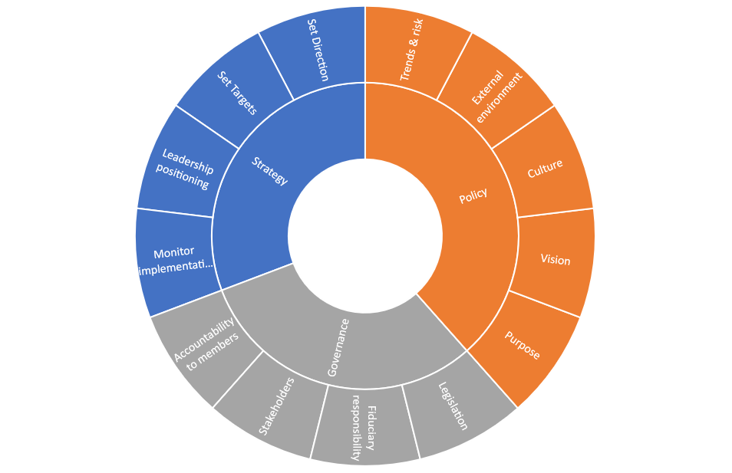
NZISM PROPOSED BOARD MODEL
Notes:
By changing to a Governance Board model, our Board would have increased responsibility for overseeing the strategy and future direction of the organisation and setting targets for the organisational management of NZISM.
They would have increased accountability to members, stakeholders and ensure we act in accordance with legislative requirements. This would also increase their fiduciary responsibility overseeing the financial management of NZISM.
They would continue to set policy around organisational culture, vision and mission statements and review trends/risk and the issues we face in the external environment.
At present they both advise and set strategy and we really need them to do either one of these, which further clarifies their role and ensures they are functioning the best way to support the organisation.

Slide 5
CURRENT LEADERSHIP TEAM
CEO
Administrator
Operations Committee x5
Mentoring Manager
CPD Manager
National Executive Committee x12 + Ops Co
Grading Panel
x4
HASANZ Panel
x8
National Manager
Grading Administrator
Notes:
This slide is here to show how top heavy the structure is, with the NEC alone having 16 members who are all required to participate in core organisational decision making.

Slide 6
PROPOSED LEADERSHIP TEAM
CEO
Administrator
Finance, Risk & Ethics Manager
Mentoring Manager
Communications Manager
Branch Networks Managers x 2
Accreditation Committee Chair
Govt & Stakeholder Manager
Tertiary Education Manager
President
Grading Administrator
CPD Manager
Branch Managers x 13
Grading Panel x 5
HASANZ Panel x 6
Paid Admin Support
Grad to Cert Panel x 3
Current Roles
New Roles
Notes:
The proposed structure allows for a representative of each of the core functions within NZISM to sit at the leadership table, as opposed to full committee members. The NEC for example would nominate 1 or 2 representatives to be the conduit between the branches and the senior leadership team.
They would ensure Branch Managers are kept across all of the issues we are discussing at the leadership team and feed back to the senior leadership team on your position, issues and other activities that we need to be across.
The core roles are broken down by function with the new roles identified in orange being a Communications Manager, Government and Stakeholder Manager and Tertiary Education Manager.
The Finance, Risk and Ethics Manager is essentially replacing the Operations Manager which Ravi currently holds. Both the CPD and Mentoring Manager roles already exist.
The committees established for grading, HASANZ and certified grading would have one representative that sits at the senior leadership team on behalf of their committees.
This proposal reduces the number of senior leadership members from 17 to 10 including the CEO and President. This will enable more regularly meetings and ensure we have people take ownership of the core benefits we deliver to our members.

Slide 7
NZISM LEADERSHIP ROLES
NATIONAL PRESIDENT
Voted member representative
Industry expert and advisor
Chair role in senior leadership team
Public relations for NZISM
Represent NZISM at industry events and international forums
Oversee CEO operational activities
CHIEF EXECUTIVE OFFICER
Lead development and implementation of the strategic plan and associated business plans
Manage the organisations operations
Financial management and reporting
Manage staff and resource requirements
Drive organisational KPIs
Represent NZISM in industry events
Notes:
We would like to suggest changing the current National Managers title to President. This aligns with other membership organisations and supports the fact that this is a member voted position, who represents NZISM members.
It clarifies the difference between the roles of CEO and President. President being an organisational representative, who is an industry expert and the CEO role being accountable for organisational and operational management.

Slide 8
NZISM LEADERSHIP TEAM ROLES
Finance, Risk & Ethics | Accreditation | CPD | Mentoring | Government & Stakeholders | Tertiary Education | Communication | Branch Network Managers
Formerly Operations Manager. Overseeing budget & investment portfolio, reviewing investments and recommending potential opportunities. Identifying & managing organisational risk including member complaints. | Leadership for the Grading Committee, Graduate to Certified Committee and HASANZ Panel. Oversees the accreditation project and its ongoing review. Manages the review of accepted qualifications. | Leads the development of ongoing CPD for members, responsible for developing an annual national programme of CPD events. | Leads and promotes the mentoring programme. Develop value proposition for mentors and mentees. | Liaison for government engagement. Responsible for promoting and developing relationships in government and industry. | Liaison for the development of relationships with tertiary providers. Leading the charge for improved H&S training outcomes in NZ. | Promoting NZISM as a thought leader in H&S in NZ and creating engagement opportunities via social media, press releases etc to the industry. Ongoing development of leadership positioning in the industry. | Representatives of the branch managers and their National Branch Committee members. Representing North and South Island branches.
Notes:
By having an owner of each function with responsibility of regularly reporting and engagement at senior leadership level, this increases our focus and hopefully the outcome will be an increase in the composition and value of these benefits. These roles will have clear job descriptions and individual business plans, all of the roles will be open for accredited members to apply.
In the current structure the role of Branch Manager encompasses a wide range of responsibilities. The core function of a Branch Manager should be to ensure we have a really well-honed local network with branches managing themselves independently and engaging with members at a grassroots level. Branch managers are the key to ensuring we are meeting local member needs, producing networking events and CPD opportunities whilst ensuring the NZISM messages are getting to our members and the members concerns and issues are being communicated upwards so the national office can support the branch network effectively.
At the moment we also add to these roles the responsibility for effectively managing and overseeing all the other elements of the organisation, which dilutes from the branches focus on local engagement of members. It is just too big a role for Branch Managers.
There will continue to be ongoing engagement around the core decisions, strategy and reporting, this won’t stop with the proposed structure but it will be provided via the reps on the leadership team.

